Slide 1
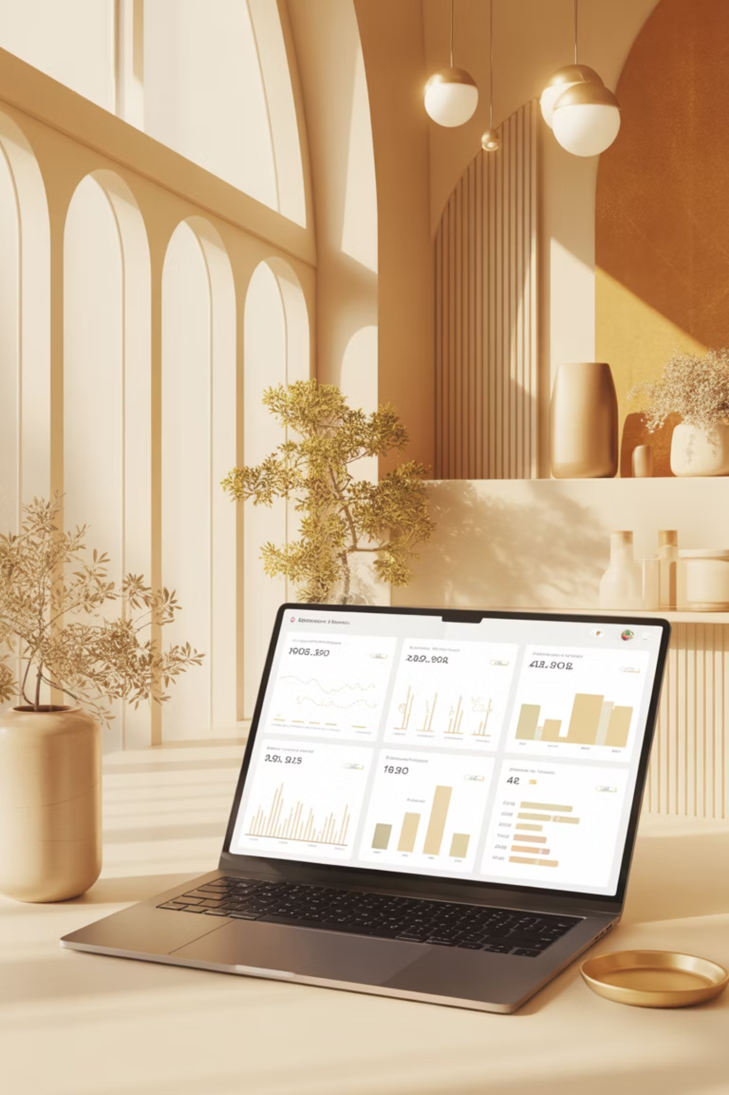
Customer Shopping Behavior Analysis
3,900 purchases • 18 features • goal: uncover spending, segments, preferences, subscriptions

Slide 2

Dataset Summary
Size
Key Features
Missing Data
Rows: 3,900 • Columns: 18
Demographics, purchase details, behavior, subscription
37 missing in Review Rating

Slide 3
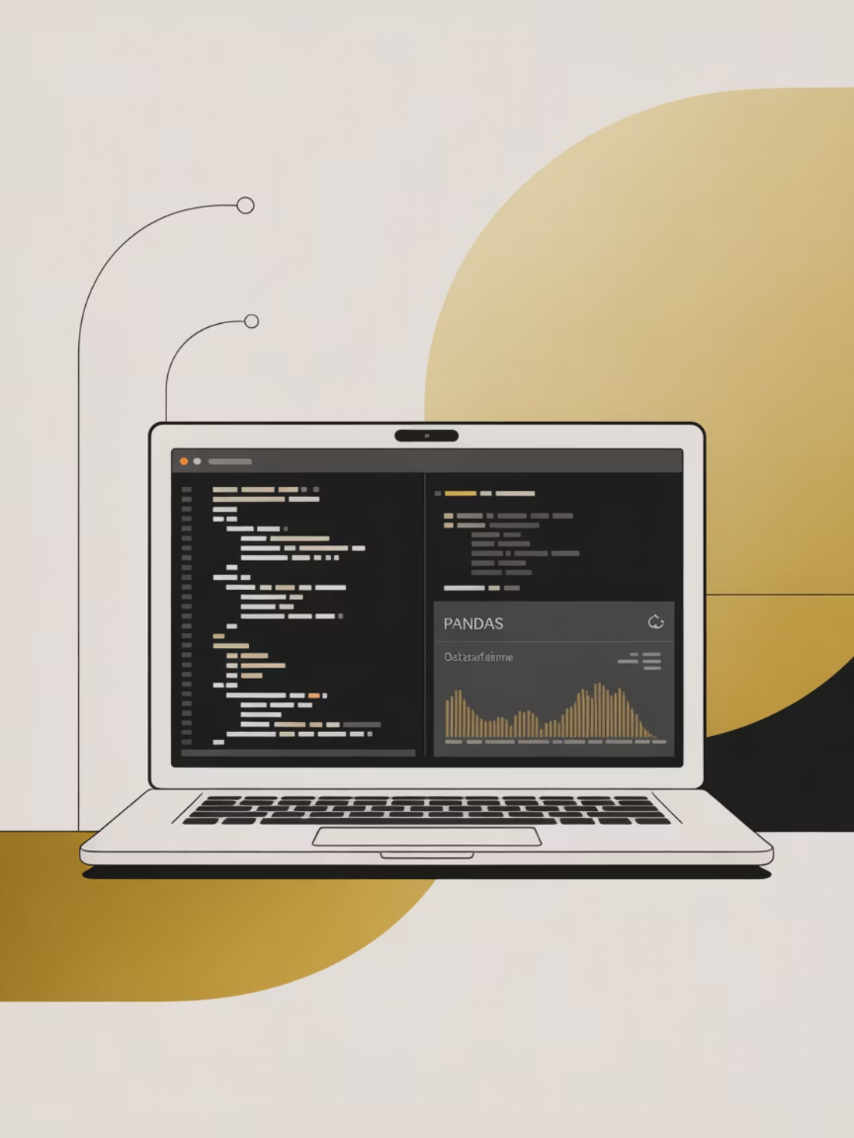
Exploratory Analysis (Python)
Data load, df.info(), describe()
Imputed review ratings by category median
Renamed columns to snake_case
Engineered age_group and purchase_frequency_days

Slide 4

Database & Consistency
Checks
Action
Verified discount_applied vs promo_code_used; dropped promo_code_used
Loaded cleaned DataFrame into PostgreSQL for SQL analysis

Slide 5
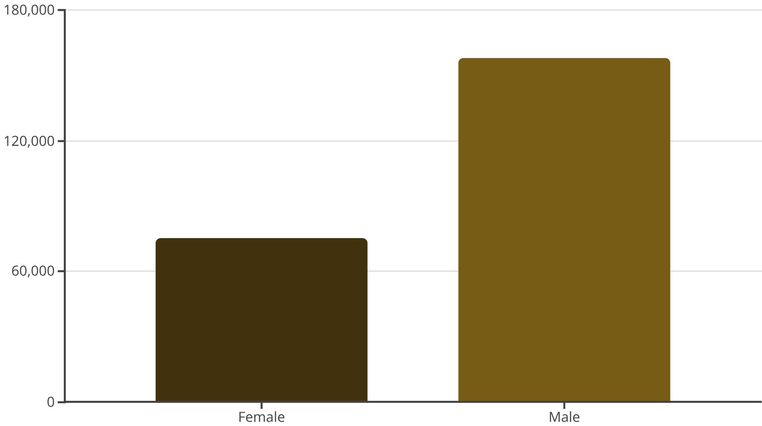

Revenue by Gender
Male revenue notably higher than female
Use targeted campaigns by gender

Slide 6
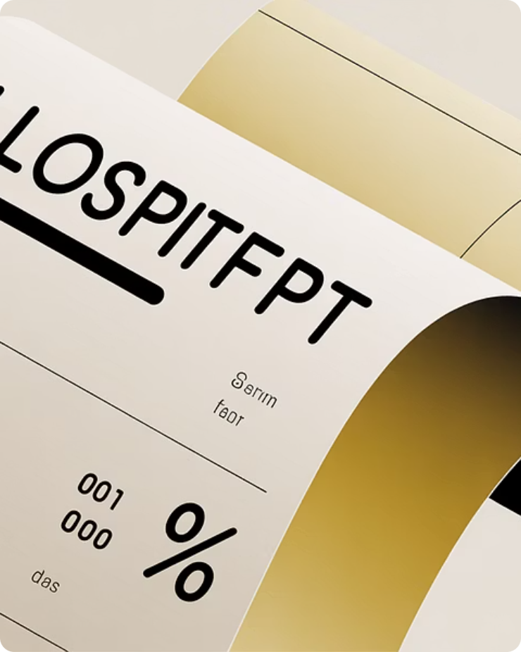
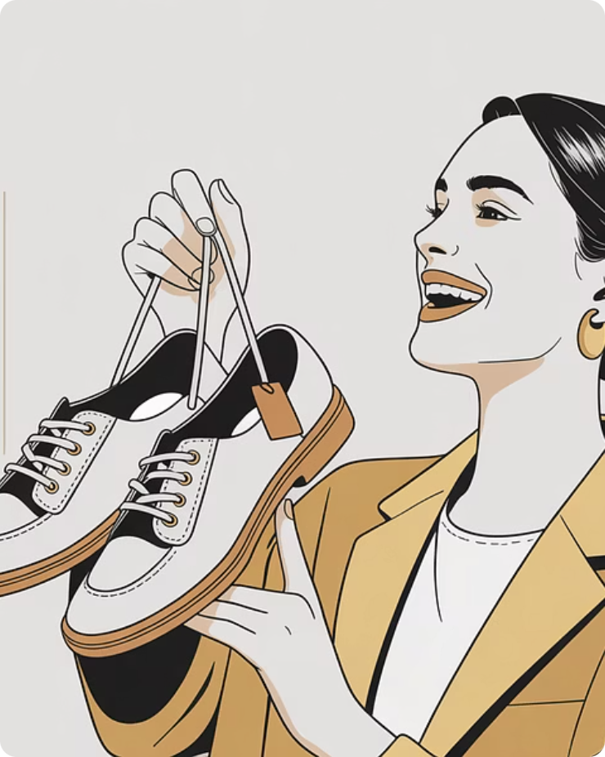
Discounts & High Spenders
Identified 839 rows of discount users; list of discount users who spent above average (examples: customer 4 spent 90, 9 spent 97)
Discount-Dependent Items
High-Spenders on Discount
Top: Hat (50%), Sneakers (49.66%), Coat (49.07%), Sweater (48.17%), Pants (47.37)
Multiple customers used discounts yet exceeded avg purchase amount

Slide 7
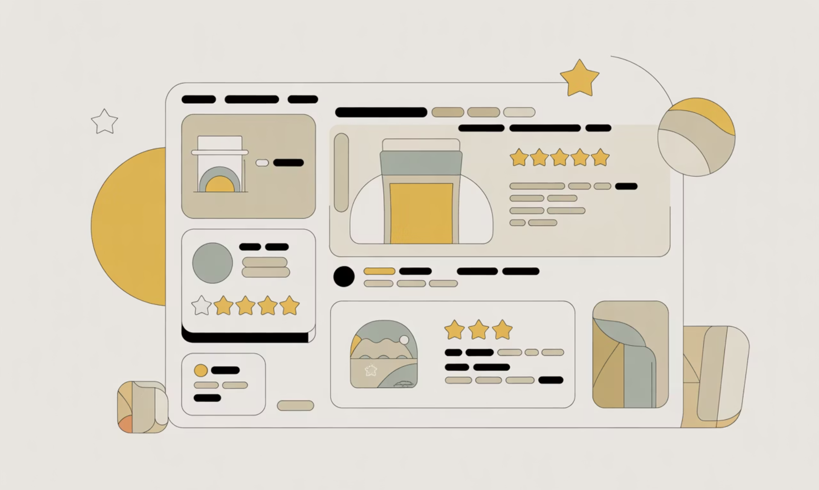
Top Products & Ratings
Gloves — 3.86
Sandals — 3.84
Boots — 3.82
Hat — 3.80
Skirt — 3.78
Prioritize top-rated items in promotions

Slide 8
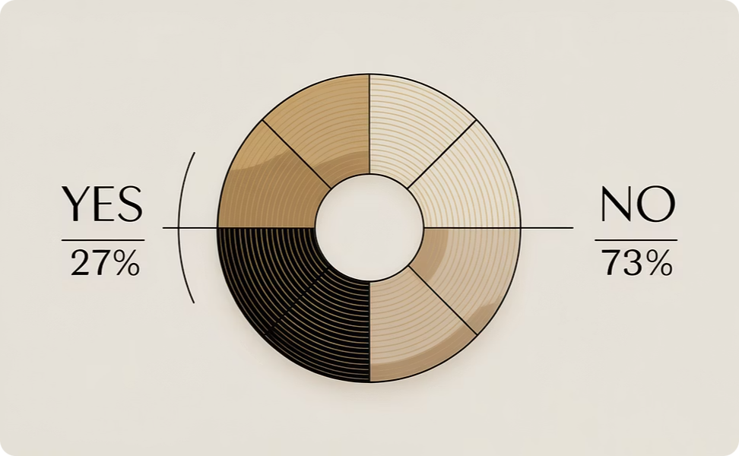
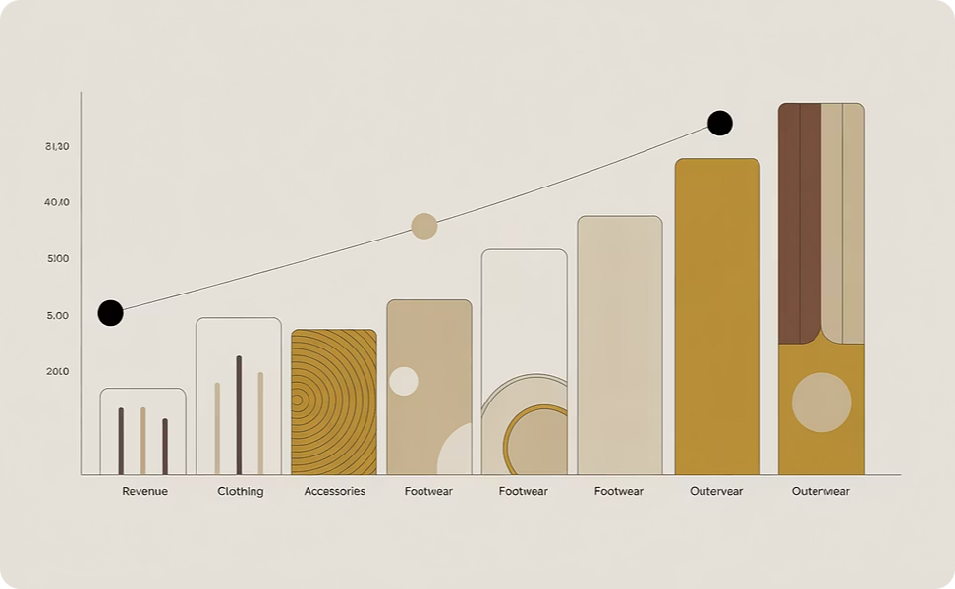
Dashboard Highlights (Power BI)
Subscriptions
Revenue by Category
Yes 27% • No 73%
Clothing $100K • Accessories $70K • Footwear $30K • Outerwear $20K

Slide 9
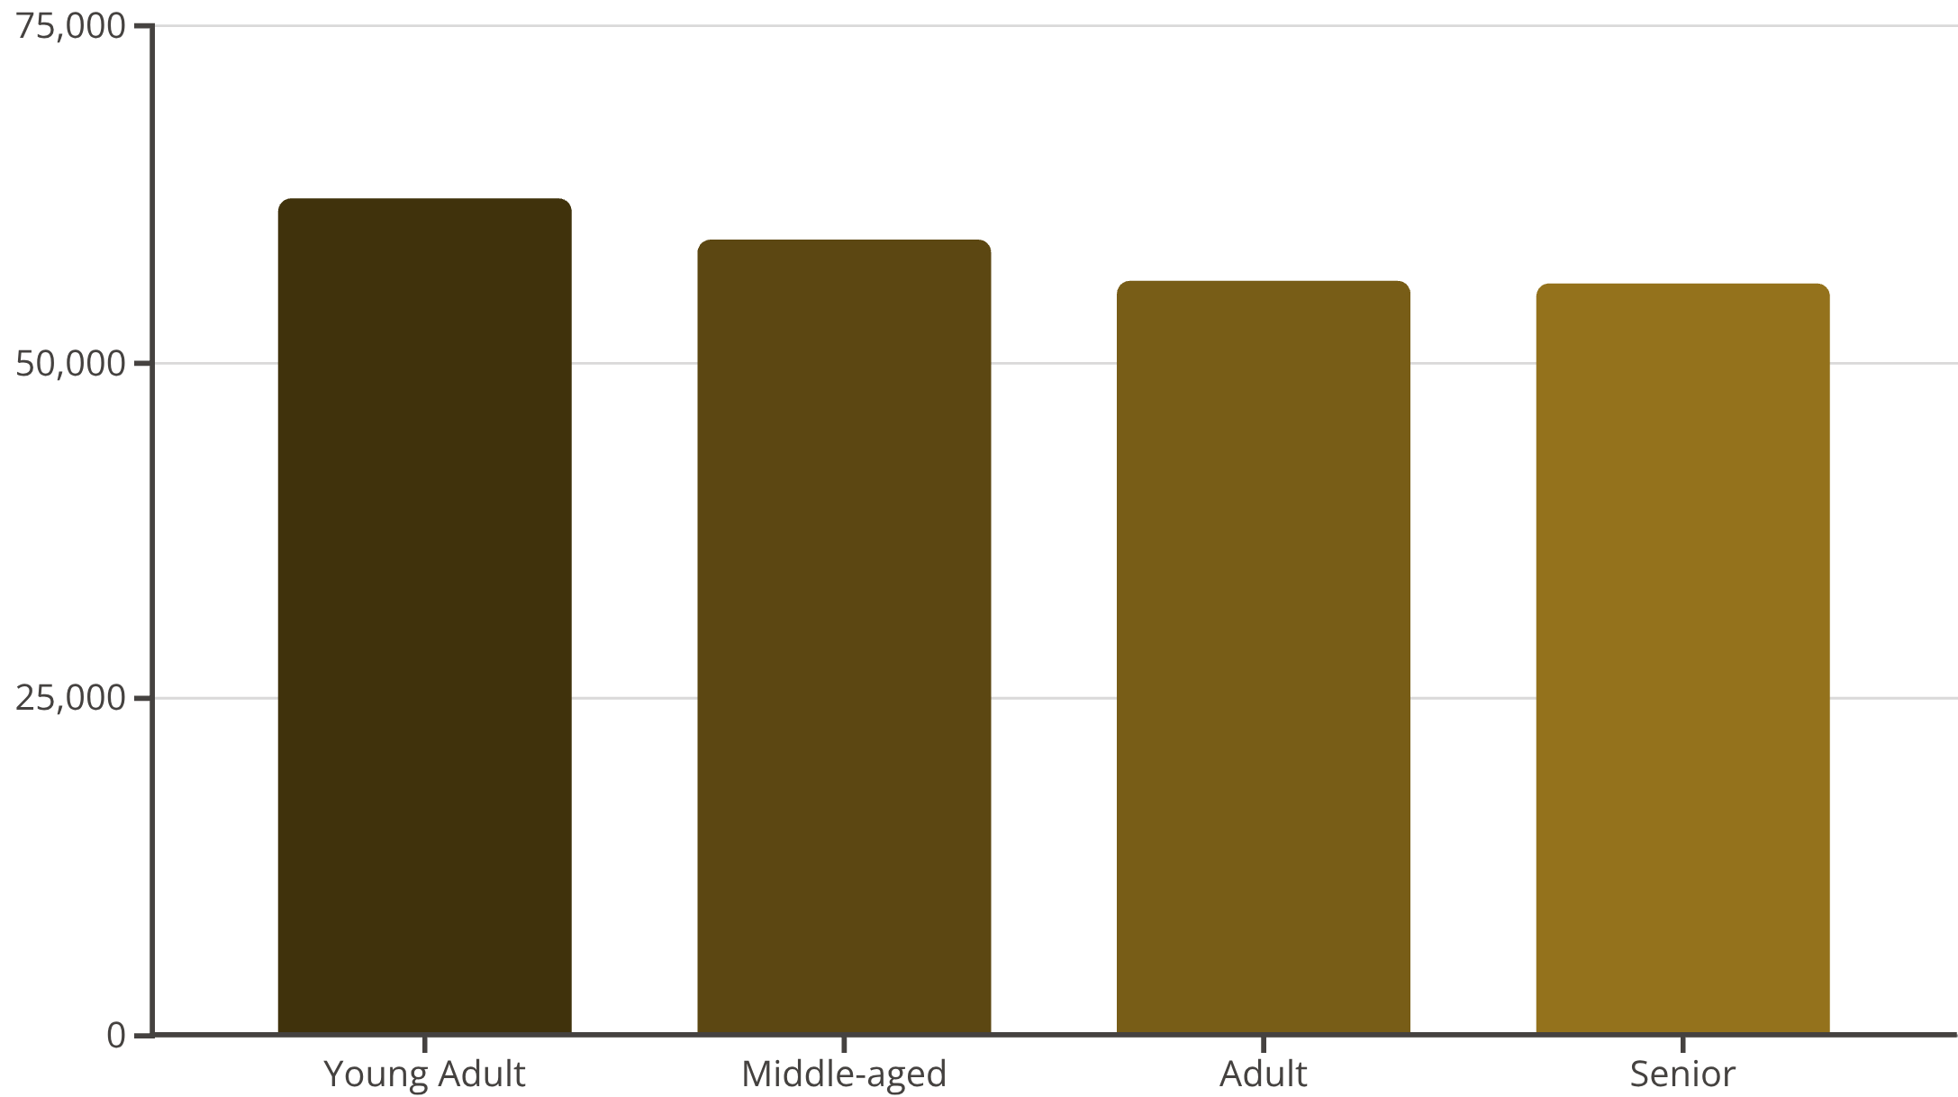
Age Groups & Revenue
Young Adult leads slightly; tailor marketing by age
Average purchase amount: $59.76 • Avg rating: 3.75

Slide 10

Business Recommendations
Boost Subscriptions
Loyalty Programs
Review Discounts
Product Positioning
Reward repeat buyers to increase loyalty
Balance sales volume with margins
Promote exclusive subscriber benefits
Feature top-rated, best-selling items
Targeted Marketing
Focus on high-revenue ages & express-shipping users

Slide 11
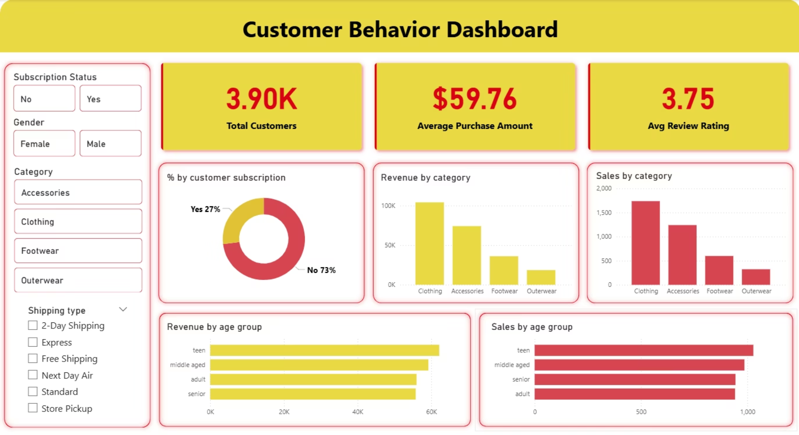
Power Bi Dashboard
interactive visualization bringing all insights together

